Slide 1
To-Do Project
By Jason Fyfe

Slide 2
Introduction
Who am I?
How did I approach the spec?
Breakdown (MVP)
Jira
Documentation
Implementation
Test
Refactor

Slide 3
Consultant Journey
What have I learned for this project?
Spring
HTML, CSS, JavaScript
Bootstrap 4
SonarQube
Java - Integration Testing
Selenium

Slide 4
Sprint Plan
What did I hope to achieve?
Improved Documentation
Improved Coverage %
Robust Back-end
A working Front-end
Improved Task Management
Task Priority (MoSCoW)

Slide 5
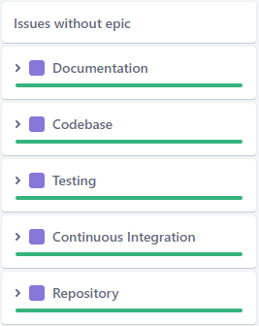
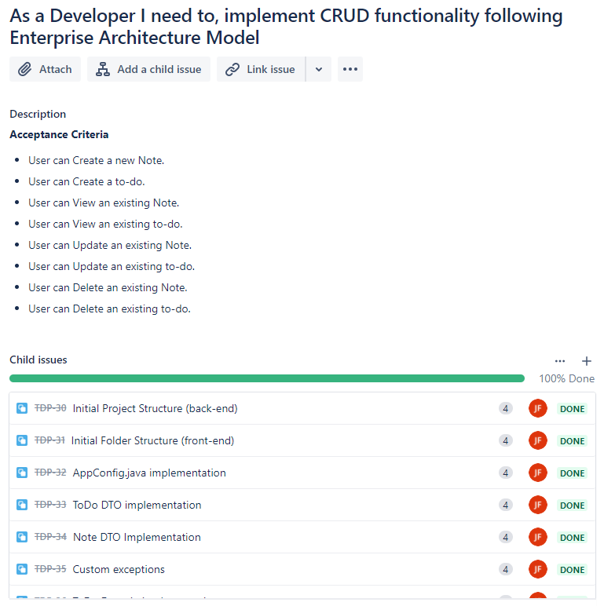
Continuous Integration
Task
Acceptance Criteria
Commit/Push
Merge
MVP Breakdown as Epics
Example Story from Jira

Slide 6
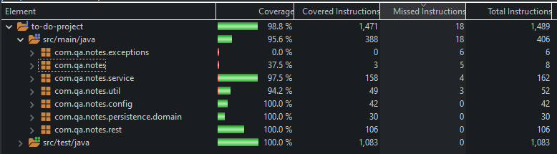
Testing
Unit Tests
Integration Tests
Static Analysis
Source Code Test Coverage - Current 95.6% - Target 80%

Slide 7
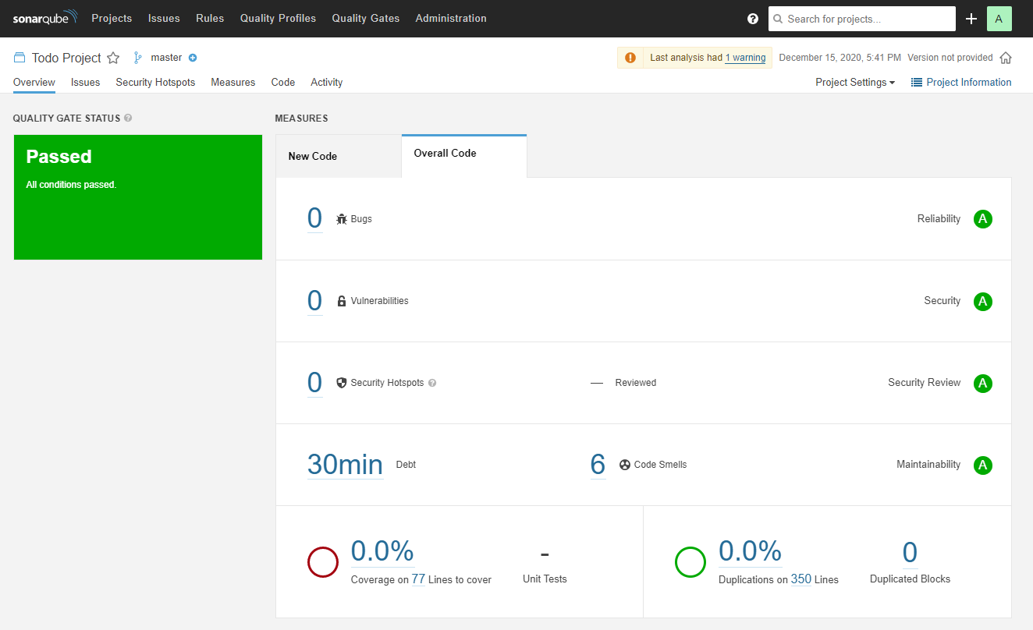
SonarQube
Initial Analysis

Slide 8
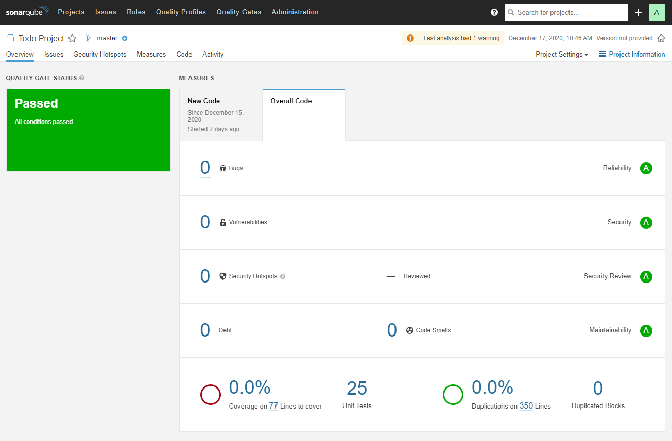
SonarQube
After Fixes

Slide 9
Demonstration

Slide 10
Sprint Review
What was completed:
Most MVP Requirements
Full CRUD functionality
Unit and Integration Testing
Front-End implementation
Complete and up-to-date Documentation
Complete use of Jira
What was left Behind:
Selenium Testing

Slide 11
Sprint Retrospective
What Happened?
What went well?
What could be improved?

Slide 12
Conclusion
Future Steps
Streamline Workflow
Continue what worked
Avoid what didn’t

Slide 13
Thank You!
Do you have any Questions?

